Slide 1


WEB SCRAPPING PROJECT ON LAPTOPS
PRESENTED BY:
Moturi Kiran Sai
Amudalapalli Lakshman
Sivvala Ganesh

Slide 2

Laptop Web Scraping Project
An in-depth analysis of laptop data scraped from e-commerce platforms, providing insights into pricing, ratings, and market trends as of January 22, 2026.

Slide 3
Project Overview: From Data Collection to Insights
01
02
03
Import Libraries & Setup
Data Scraping & Extraction
Data Structuring with Pandas
Initiate the project by importing essential Python libraries like BeautifulSoup for parsing HTML and Requests for fetching web pages, alongside NumPy and Time for data handling and performance monitoring.
Execute a robust web scraping loop across multiple pages, systematically extracting key laptop attributes such as product name, price, rating, features, and discount information. Each page's processing time is carefully logged to monitor efficiency.
Transform the collected raw data into a structured Pandas DataFrame, organizing product details, pricing, ratings, and specifications for subsequent analysis.
04
05
Cleaning & Preprocessing
Analysis & Visualization
Conduct comprehensive univariate, bivariate, and multivariate analyses, employing various visualization techniques to uncover trends, correlations, and insights into the laptop market.
Address missing values and duplicate entries within the dataset to ensure data integrity and reliability, preparing it for in-depth statistical and visual analysis.

Slide 4
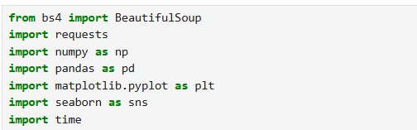
Initial Setup: Importing Libraries for Web Scraping
The project begins with importing crucial Python libraries
that facilitate web scraping and data manipulation. These
libraries are the foundation for extracting and processing
information from the web.
BeautifulSoup: For parsing HTML and XML documents.
requests: To make HTTP requests to fetch web pages.
numpy: For numerical operations, especially handling missing data.
time: To monitor the execution time of various scraping tasks.
from bs4 import BeautifulSoup import requests import numpy as np import time

Slide 5
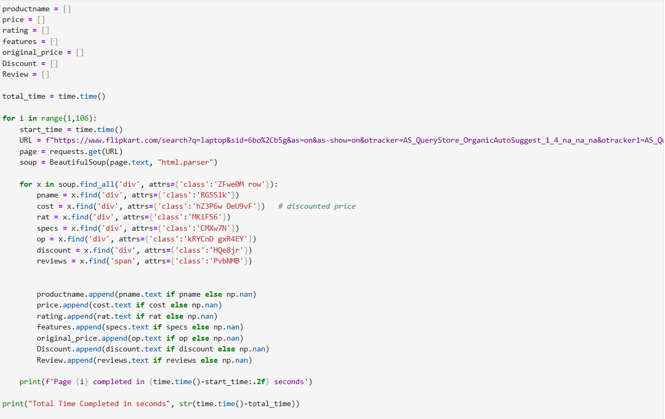
Efficient Data Collection: Iterating Through Pages
A loop was implemented to scrape data from 105 pages of laptop listingsThisterative
process ensures comprehensive data collection, capturing a broad spectrum of products.
Each page was processed remarkably quickly, with most pages completing in under a second. The entire scraping process for 105 pages concluded in approximately 41 seconds, demonstrating the efficiency of the setup.

Slide 6
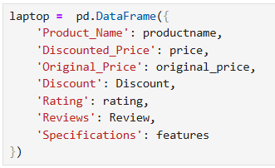
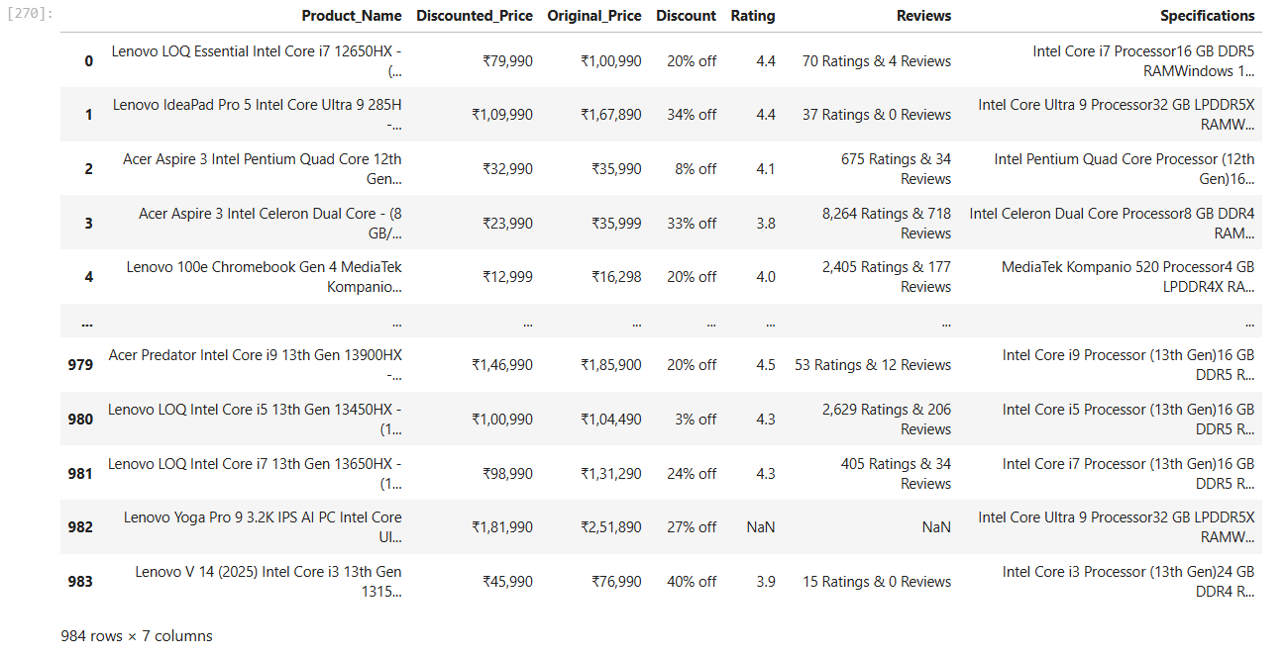
Structuring the Data: From Raw Scrapes to DataFrame
After extraction, the raw data points are consolidated into a
structured Pandas DataFrame. This step is critical for organizing
the information into a format suitable for analysis.
import pandas as pd df = pd.DataFrame({ 'Product_Name': productname, 'Discounted_Price': price, 'Original_Price': original_price, 'Discount': Discount, 'Rating': rating, 'Reviews': Review, 'Specifications': features, 'Page_Number': pagenum })

Slide 7
Price Cleaning & Standardization
Converted Discounted Price and Original Price from text (₹ symbols) into numeric values
Extracted Discount % into a separate numeric column for comparison analysis
Customer Feedback Separation
Split combined review text (e.g., “70 Ratings & 4 Reviews”) into:
Rating
Rating Count
Review Count
Product Information Structuring
Separated long product titles into clear and meaningful columns:
Product Name
Specifications
Technical Feature Extraction
Extracted individual attributes from specifications:
Brand
Processor
RAM (GB)
Storage (GB)
Operating System
Memory Type

Slide 8
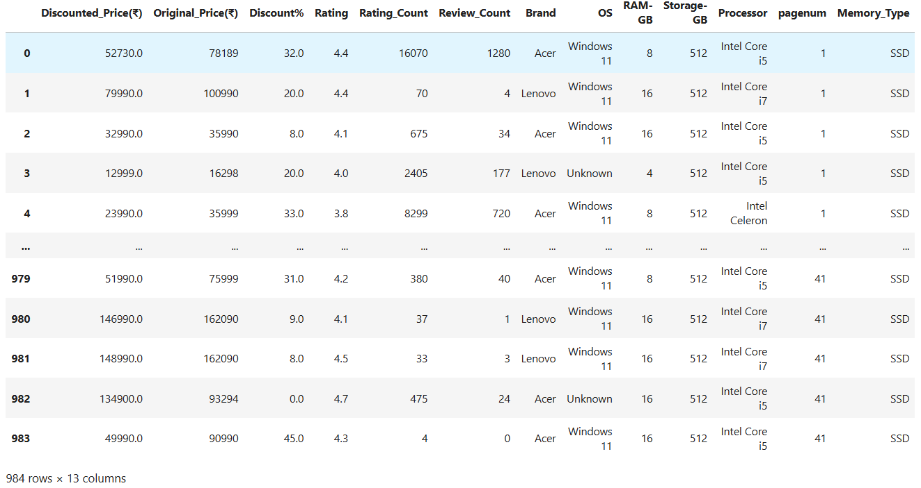

Slide 9
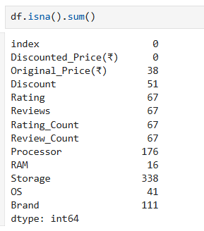
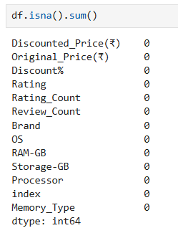
Data Refinement: Cleaning and Handling Imperfections
Data cleaning is an essential step to ensure the accuracy and reliability of our analysis. This involves identifying andaddressing missing values and removing duplicate entries.
Missing Values Check
Filling Missing Data
Initially, several columns had missing
data, particularly 'Original_Price’,
'Discount', 'Rating', and 'Reviews'.
Missing numerical values were imputed using the median of their respective columns to maintain data distribution.
df.isnull().sum()
df.fillna(df.median(numeric_only=True), inplace=True)
Duplicate Removal
To prevent skewed analysis, duplicate rows were identified and
removed, resulting in a clean dataset for further processing.
df.duplicated().sum()
df.drop_duplicates(inplace=True)
df.duplicated().sum()

Slide 10
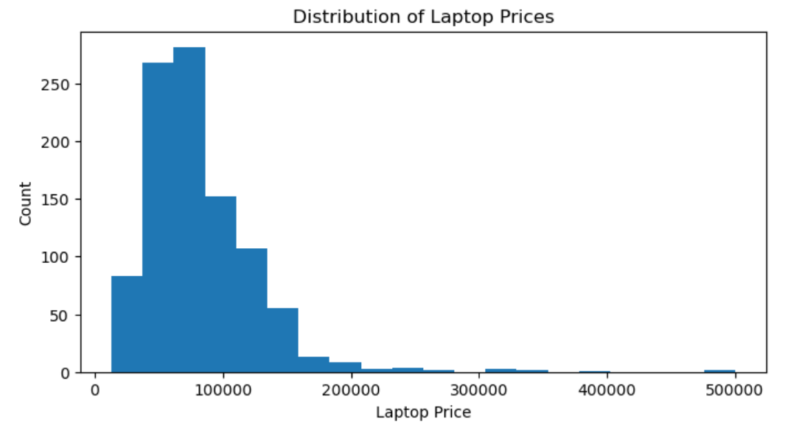
Univariate Analysis: Understanding Individual Data Distributions
Univariate analysis provides insights into the
distribution of individual variables,
offering a foundational understanding of the
dataset.
We examined the
distribution of 'Discounted_Price' and 'Rating'.
Observation
,
• Most laptops are in the mid-price range The highest concentration of laptops falls roughly between ₹40,000 and ₹1,00,000, showing this is the most common buying segment.
• Right-skewed distribution The graph has a long tail toward higher prices, meaning a small number of laptops are very expensive compared to the majority.
• Presence of extreme outliers A few laptops reach prices near ₹3,00,000 – ₹5,00,000, which could be gaming/workstation models.

Slide 11
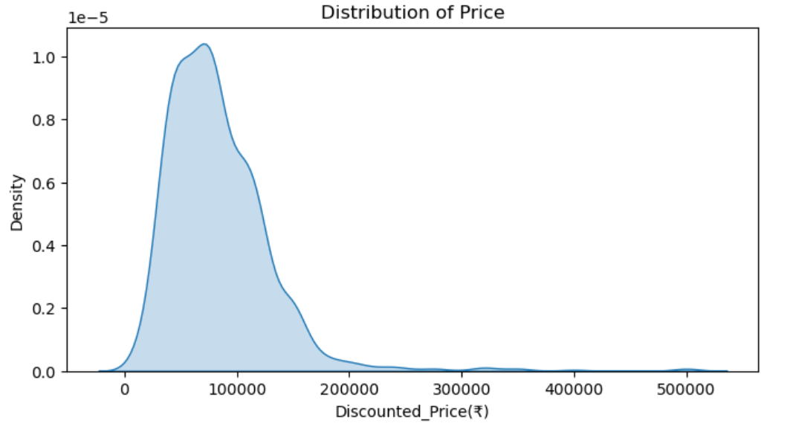
Distribution of Laptop Price
The histogram illustrates that most laptops are priced between
50,000 and
75,000, indicating a strong concentration in this mid-range
segment. There's a
notable right-skew, with fewer products in the higher pric
e brackets.
Density of Discounted Prices
The KDE plot reveals a bimodal distribution for discounted
prices, with peaks around 40,000 and 55,000. This suggests
two distinct price clusters within the discounted laptop
market.
Observation
The KDE plot indicates a right-skewed price
distribution, showing that most laptops are priced in
the lower range with a long tail toward higher prices.

Slide 12
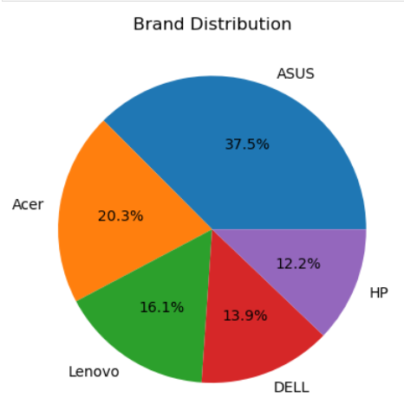
Brand Distribution – Pie Chart Explanation
A pie chart is a circular graphical representation used to show how different parts contribute to a whole. The entire circle represents 100% of the data, and each slice indicates the proportion of a specific category. Pie charts are easy to understand and are commonly used to compare percentages, distributions, or shares among categories.
Observation
The pie chart represents the distribution of laptop brands based on their percentage share.
Asus holds the highest share with 37.5%, indicating it is the most preferred brand.
Acer follows with 20.3%, showing strong market presence.
Lenovo accounts for 16.1%, maintaining a moderate share.
Dell contributes 13.9%, slightly lower compared to Lenovo.
HP has the smallest share at 12.2%.

Slide 13
Key Metrics: Outlier Detection and IQR Values
Understanding the interquartile range (IQR) and detecting outliers helps in identifying
data variability and potential anomalies in laptop prices, ratings, and discounts.
1
2
3
IQR Calculation
Outlier Detection
Numerical Column Statistics
The IQR measures the spread of the middle 50% of the data. For 'Discounted_Price', the IQR is 18,887, indicating a significant range in the central price distribution.
Outliers were identified using the 1.5 * IQR rule. Each numerical column, including 'Discounted_Price', 'Rating', and 'Reviews_Count', showed the presence of outliers, signaling extreme values.
A detailed DataFrame outlines the Q1, Q3, and IQR values for all numerical features, providing a comprehensive view of their statistical spread.
Q1 = 37990.00Q3 = 56877.00IQR = 18887.00
{'Discounted_Price': 13,'Rating': 13,'Reviews_Count': 13}
Discounted_Price
37990
56877
18887
Discount
23
41.75
18.75
Rating
4.1
4.4
0.3
21
Reviews_Count
224.25
2345
2120.75

Slide 14
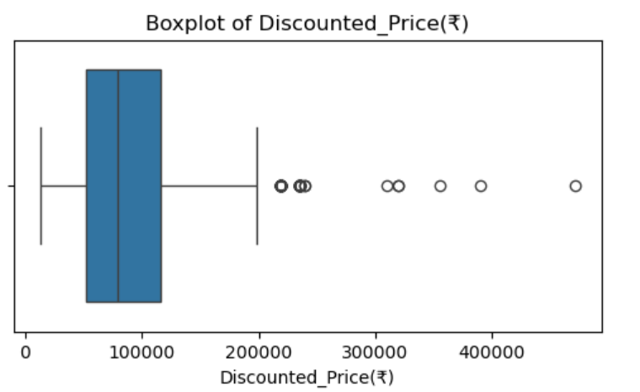
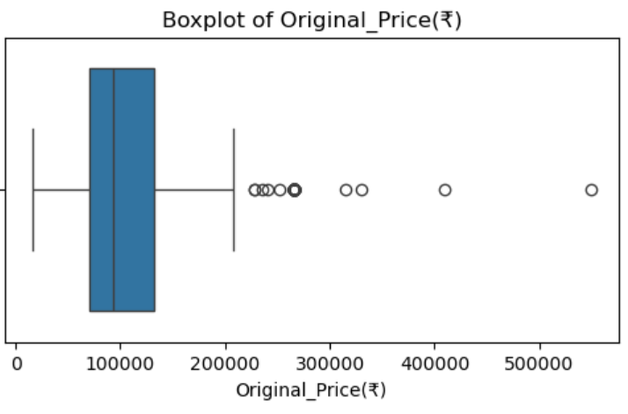
Checking outliers
Observation
Price data shows several extreme high values far above the range.
The distribution is highly right-skewed, with a few premium products affecting the spread.
The average price is inflated due to the presence of these outlier values.

Slide 15
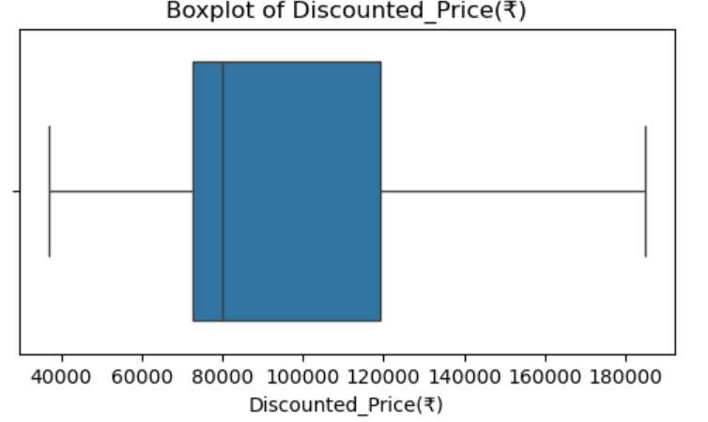
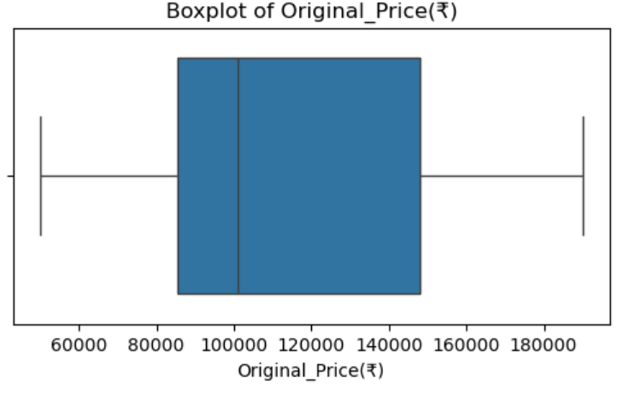
After removing outliers
Observation
The price distribution becomes more balanced and concentrated within a normal range.
Skewness is reduced, making the data more suitable for analysis and modeling.
The mean and median prices become closer, giving a more realistic picture of typical product prices.

Slide 16
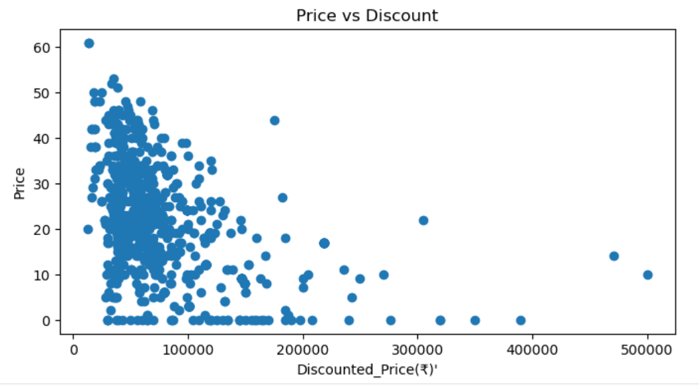
Bivariate Analysis: Price, Discount, and Ratings
Bivariate analysis explores the relationships between pairs of variables, offering deeper
insights into how discounted prices correlate with ratings and discounts.
Price vs. Discount
A scatter plot reveals a general
trend where higher discounted
prices are associated with higher
discounts, though with
considerable variability. This
suggests that more expensive
laptops might also offer higher
percentage markdowns.
Observation
Most products fall in the lower price range with varying discounts.
High-priced products are fewer and usually have lower discounts.

Slide 17
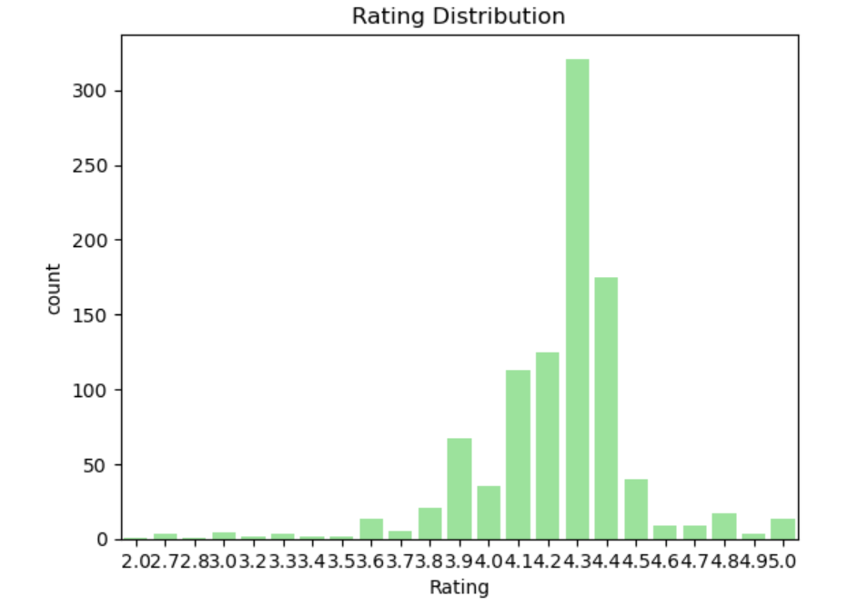
Rating Distribution
The rating distribution shows a peak at 4.3, indicating
that a significant portion of laptops receive favorable
customer reviews. This highlights product quality and
customer satisfaction.
Observation
Most products/services have ratings clustered
around 3.5–4.5, indicating generally positive feedback.
The highest frequency occurs at around 4.0–4.4, showing that this is the most common rating.
Very few ratings are below 3.0 or above 4.5, suggesting extremes are rare.
The distribution is right-skewed with a long tail toward higher ratings, implying more customers give high ratings.

Slide 18
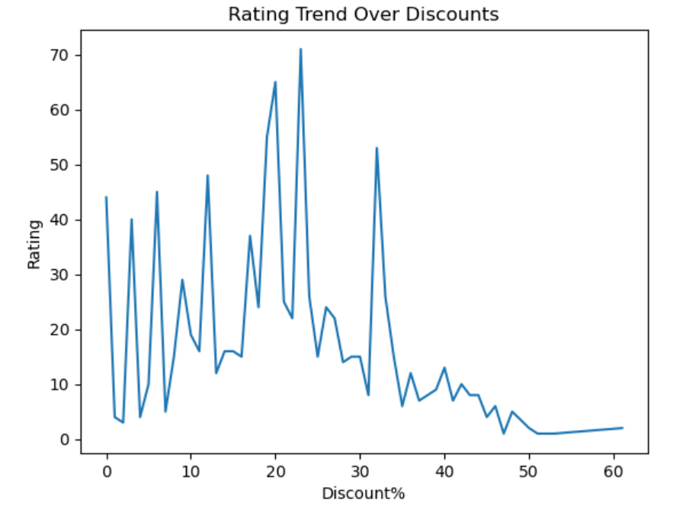
Rating Trend Over Discounts
A line chart illustrates the relationship between discount percentages and average ratings. Certain discount tiers,
particularly around 38% and 47% off, show higher rating counts, hinting at customer preference for specific deals
Observation
Ratings are highly variable at lower discounts (0–20%), showing inconsistent customer satisfaction.
The peak rating frequency occurs around 20–25% discount, suggesting moderate discounts attract better reviews.
Extreme discount ranges (50–60%) have very few ratings, implying limited sales or low customer engagement at these discounts.
Overall trend suggests a moderate discount range is optimal for higher ratings.

Slide 19
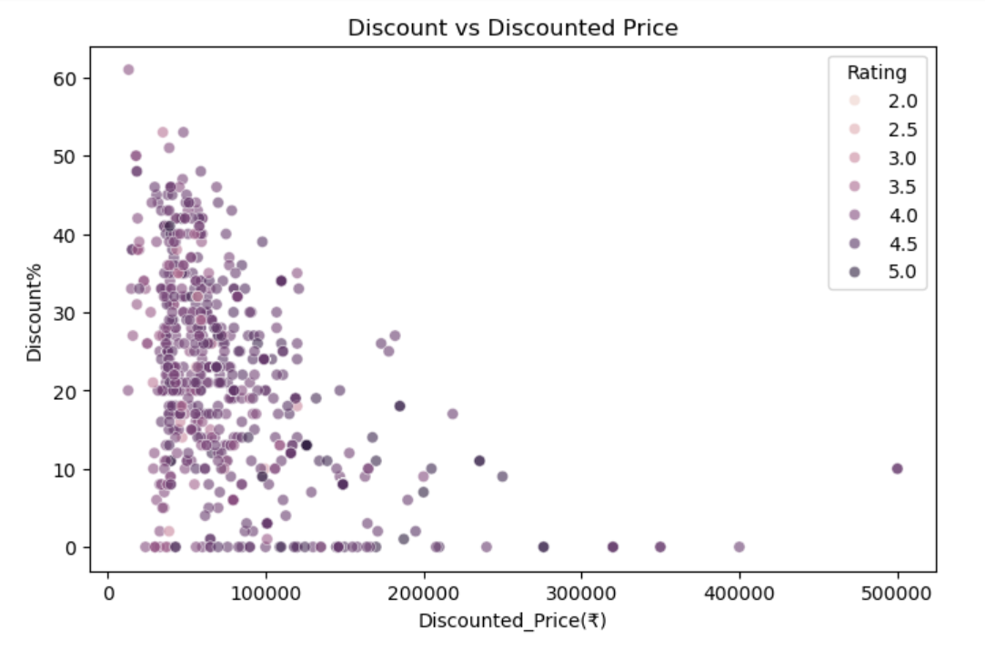
Multivariate Analysis: Interdependencies and Correlations
Multivariate analysis examines the relationships among three or more variables, offering a holistic view of the factors influencing laptop pricing, discounts, and customer ratings.
Discount vs. Discounted Price & Rating
A scatter plot with color-coded ratings reveals that higher-rated laptops tend to appear at various discounted price points and discount percentages, indicating that quality isn't solely tied to price or discount level.
Observation
Products with lower discounted prices tend to have higher discount percentages, meaning budget items often receive bigger markdowns.
High-priced products usually have smaller discount percentages, suggesting limited price cuts on premium items.
There is a negative relationship between price and discount% — as discounted price increases,
discount percentage generally decreases..

Slide 20
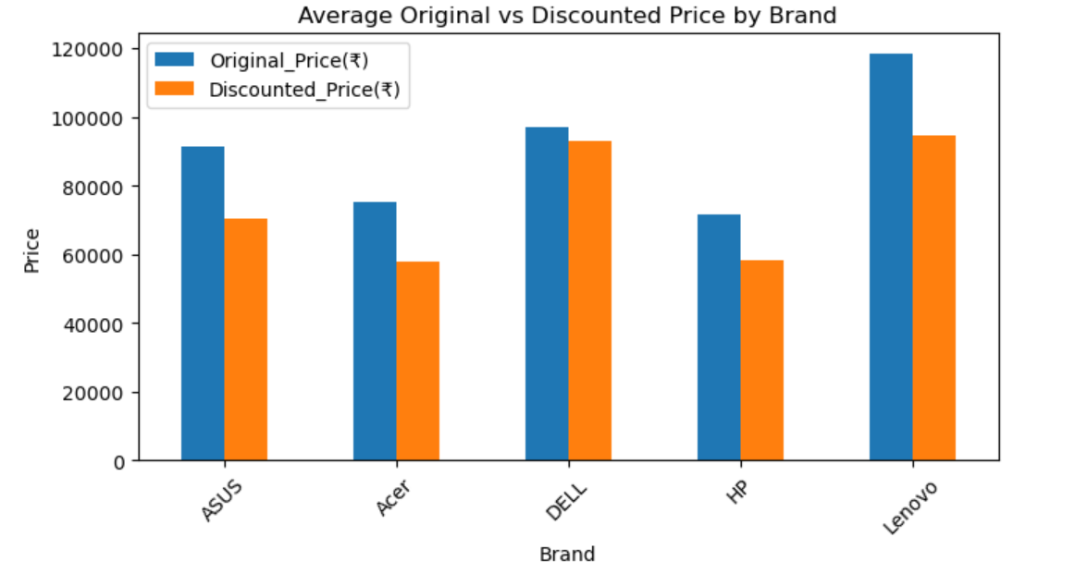
Comparison between Discount
Price by Original Price
A grouped bar chart illustrates how 'Discount' and 'Discounted_Price' counts vary across different 'Rating' values. The highest frequencies for both metrics are observed around a rating of 4.3, reinforcing the popularity of well-rated products.
Observation
Lenovo and Dell have the highest average original prices, indicating more premium pricing.
All brands show a clear drop from original to discounted price, confirming consistent discounting across brands.
Acer and HP fall in the lower price range, making them more budget-friendly compared to ASUS, Dell, and Lenovo.
.
Dell maintains higher pricing even after discounts, suggesting a more premium positioning compared to Acer and HP.

Slide 21
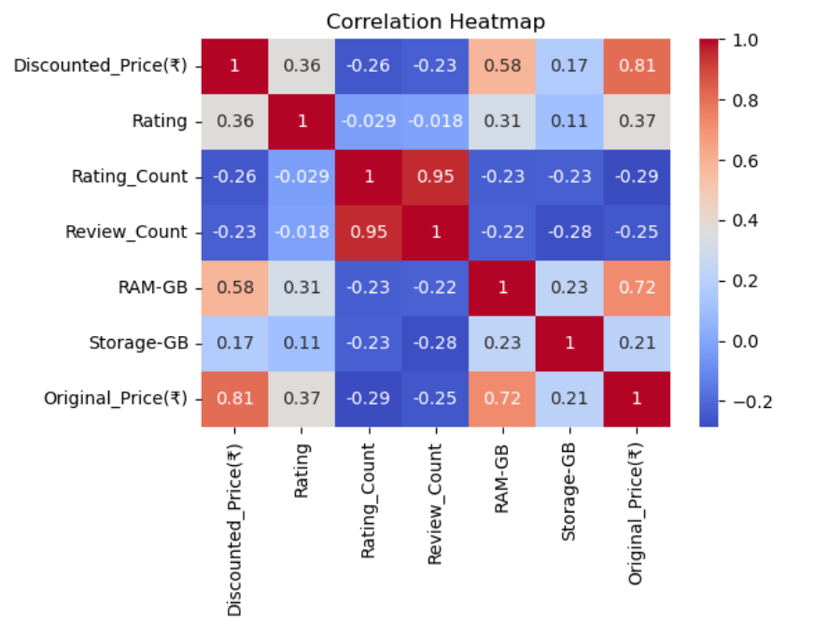
Correlation Heatmap
The heatmap shows a moderate positive correlation between 'Discounted_Price' and 'Rating' (0.28), and a weak positive correlation between 'Rating' and 'Reviews_Count' (0.18). 'Discounted_Price' and 'Reviews_Count' have a slight negative correlation (-0.14).
Observation
Original Price and Discounted Price show a strong positive correlation, meaning expensive products remain relatively
expensive even after discounts.
RAM has a strong positive relationship with price, indicating higher RAM models tend to cost more.
Rating Count and Review Count are highly correlated, which makes sense since more reviews usually lead to more ratings.
Ratings have only a weak correlation with price and specifications, suggesting customer satisfaction isn’t determined purely by cost or hardware.

Slide 22


